Slide 1

Safety floater
IoT group project for coastal tourism
Blue Growth
Daniele Bufalieri, Marco Calamo, Ivan Giacomoni

Slide 2
What is the problem?
The problem is the security of swimmers because of the boats that do not respect the safety distance from the coast.
It is a threat for the tourists and also for the environment because the pollution near the shore.
There is not a direct communication to the authorities

Slide 3
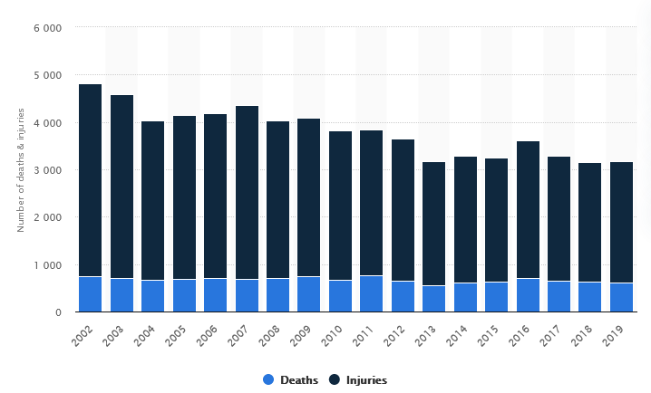
Boat accidents FROM 2002 TO 2019

Slide 4
Key functionalities
Real time reporting to authorities of violations
Create a safer holiday for tourists
Improve water quality near the shore
Decrease number of accidents
Provide an user friendly dashboard in order to monitor violations

Slide 5
Iot architecture
LoraWAN
MQTT
MQTT
Safety Floater
Sea Station
Cloud Server
Frontend
REST

Slide 6
Sensors & data collected
MPU-9250 9DOF Module 9 Axis Gyroscope Accelerometer Magnetic Field Sensor
HC-SRF04 Proximity sensor
GPS
Voltage consumption sensor

Slide 7
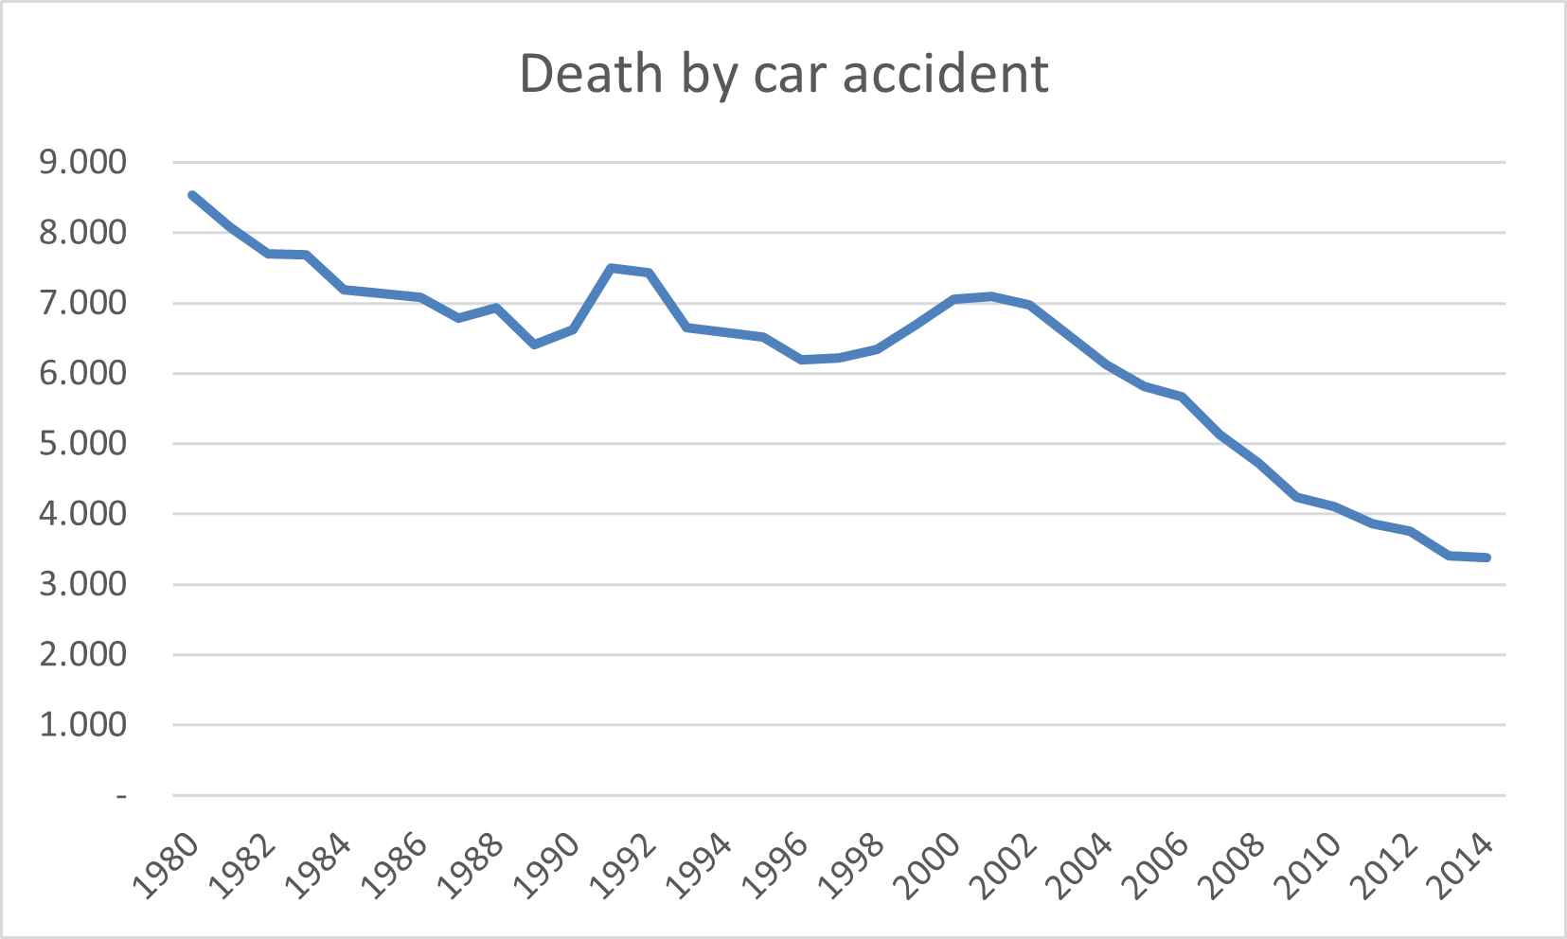
Collective intelligence
Our purpose is to replicate this trend of death by car accident since autovelox was introduced, but in the context of accident caused by boats introducing our system in order to prevent an increasing number of deaths.

Slide 8
Actuators
Acoustic alarm
Visual alarm
Camera
DC motor

Slide 9
evaluation
Network technologies
Given that Safety Floater will communicate with the Sea Station via LoraWAN, the evaluation of the performance of the network technologies will be measured with Iot-lab, because there we have the right tools compared to a generic user. We want to notice that we are not able to analyze the network consumption of physical devices of our personal Safety Floater.
Embedded devices
During the development phase we will use Iot-lab to have an estimation of the power consumption of the embedded device (Nucleo f401-re), because even if on Iot-lab are not available our specific sensors we can obtain a rough result. During the final testing we will use a voltage measure sensor in order to monitor the real consumption.
End-user point of view
From an end-user point of view the response time is conditioned by LoraWAN, by the bandwith of the channel linking the Sea Station to the cloud, and by the type of protocol used (e.g.: HTTP-REST / MQTT). From a quantitative point of view, we will use timestamps at the generation of the packet and one at the receiving of the packet.

Slide 10
Constraints
All sensors are constantly sampled
Bandwith and latency limitated by the capacity of LoraWAN
Waterproof sensors
Energy is a key factor in Safety Floater, we use solar panel in order to increase the battery life
Power consumption reduced at minimum

Slide 11
PERFOMANCE EVALUATION
Battery life: it’s crucial because these are stand alone device (mAH and V)
Latency: is the most important factor because Safety Floater is a real time system (ms)

